Slide 2
WHAT HAPPENED AFTER 9/11/2001?
a
Notes:
After September 11, people come together. They started to understand how others felt. People thought that together they could get through anything. They began to help each other.
People were sad, but because everyone was working together, they thought that everything was going to be ok. Many people stopped thinking about how we are all different. They thought more how we are all alike.

Slide 3
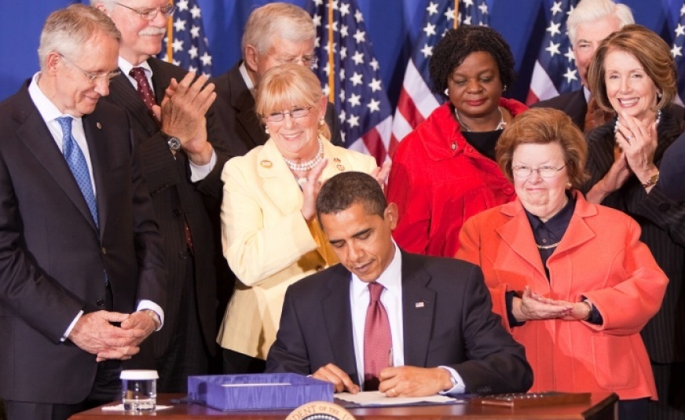
HOW DID 9/11 BECOME A DAY OF SERVICE?
Notes:
The families of people who died wanted people to remember this feeling of togetherness. They wanted a way for Americans to remember their lost loved ones. They decided to make September 11th a Day of Service.
Congress and the president made September 11 a National Day of Service in 2009.
The 9/11 National Day of Service is also known as “9/11 Day.”

Slide 4
WHAT HAPPENS NOW ON 9/11?
Notes:
September 11 is now the largest day of service in America.
Many people help others, do good deeds, and are kind.
They try to make more people want to do good deeds.

Slide 5
WHAT CAN SEPTEMBER 11TH TEACH US?
Notes:
We can learn a lot from September 11th.
When things are hard, people can work together.
Being kind and doing good deeds can make things better.
Everyone can help.
We are more alike than we are different.

Slide 6
WHAT KIND OF GOOD DEEDS CAN YOU DO?
HOME
COMMUNITY
SCHOOL
Notes:
You can do good deeds at home, at school, or in the community.
At home you can:
Pick up your toys.
Help your family.
At school you can:
Help your teachers.
Be a better friend.
Pick up trash when you see it.
In your community you can:
Give away clothes or toys that you don’t use.
Clean up an outdoor area.
Help at a community garden.
Collect cans for your local food bank.

Slide 7
EVERYONE CAN DO A GOOD DEED!
WATCH THE VIDEO
https://www.youtube.com/watch?v=gHc901z_w4o
Notes:
Let’s watch a video about doing good deeds.

Slide 8
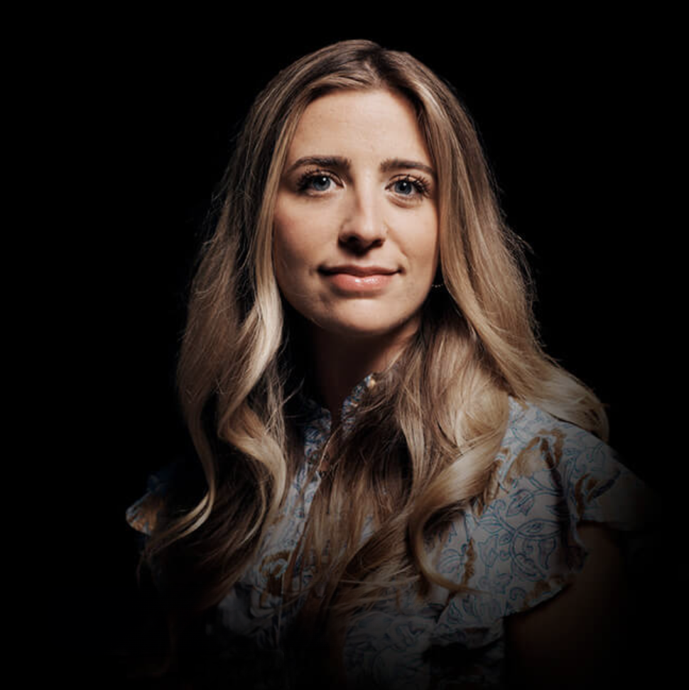
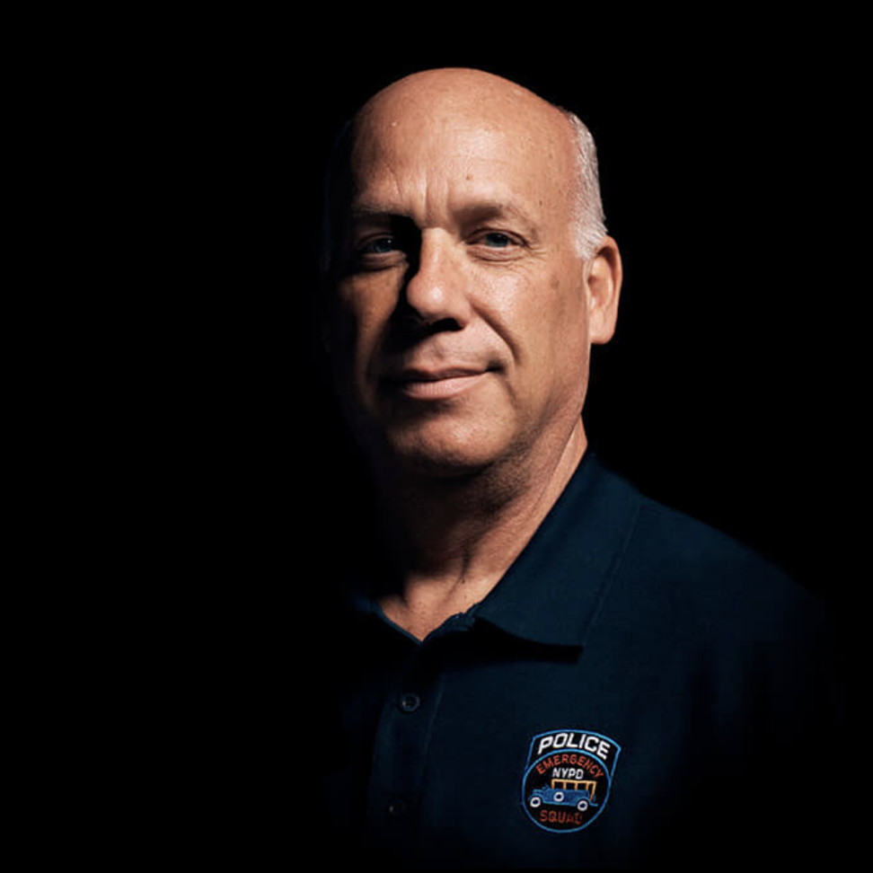
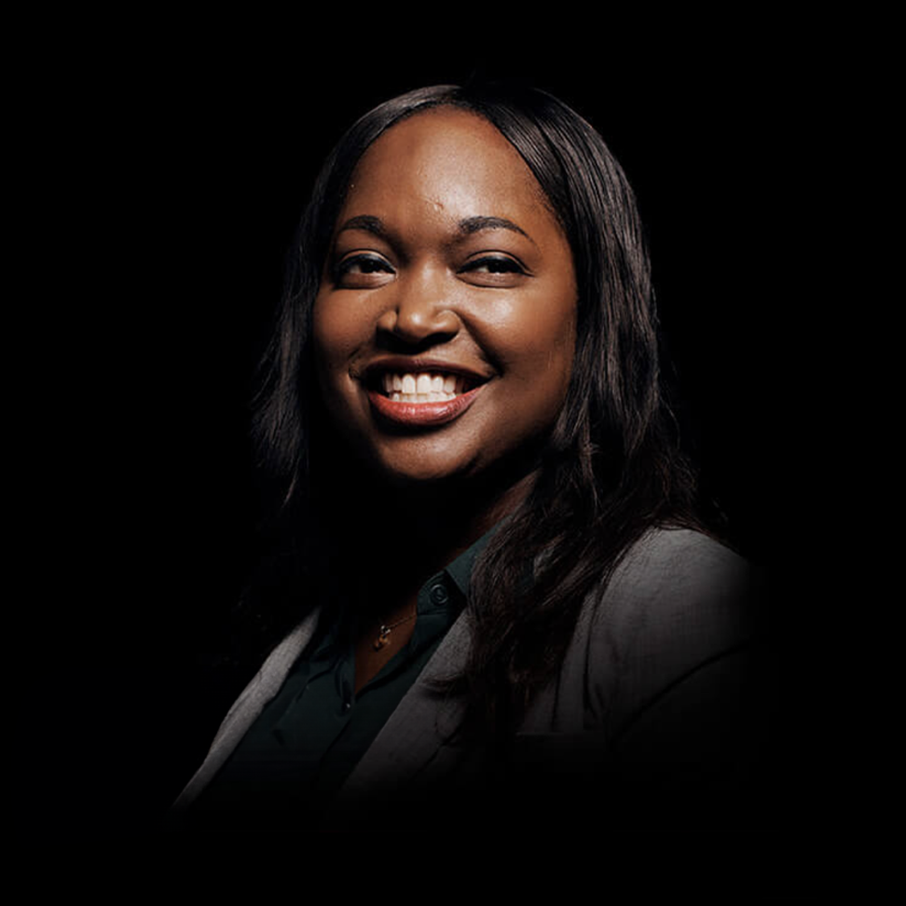
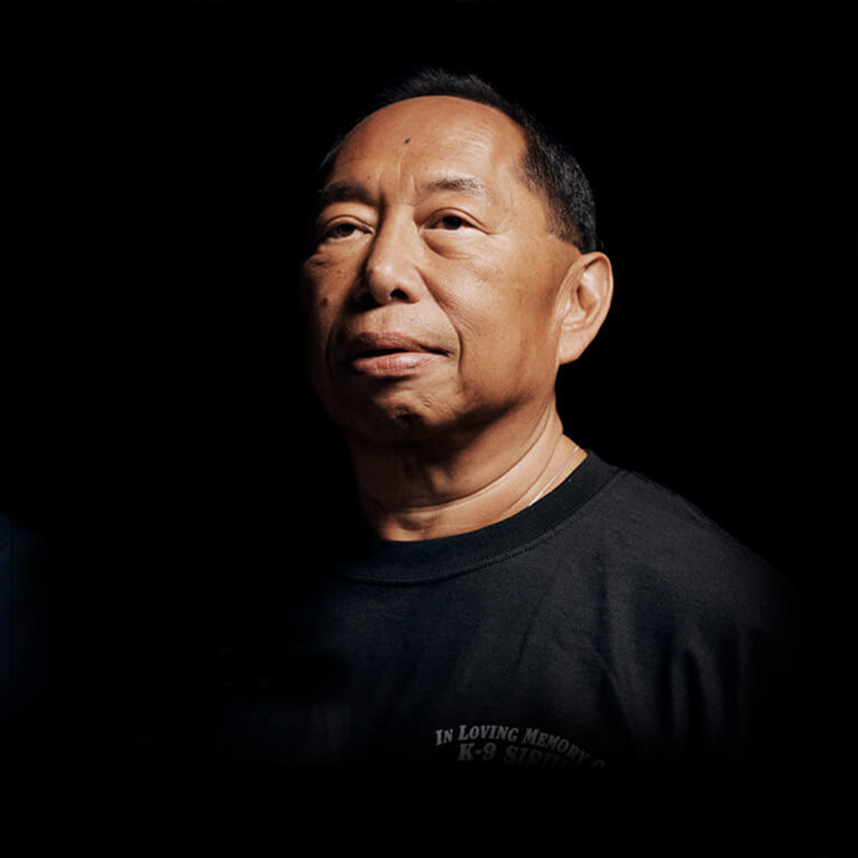
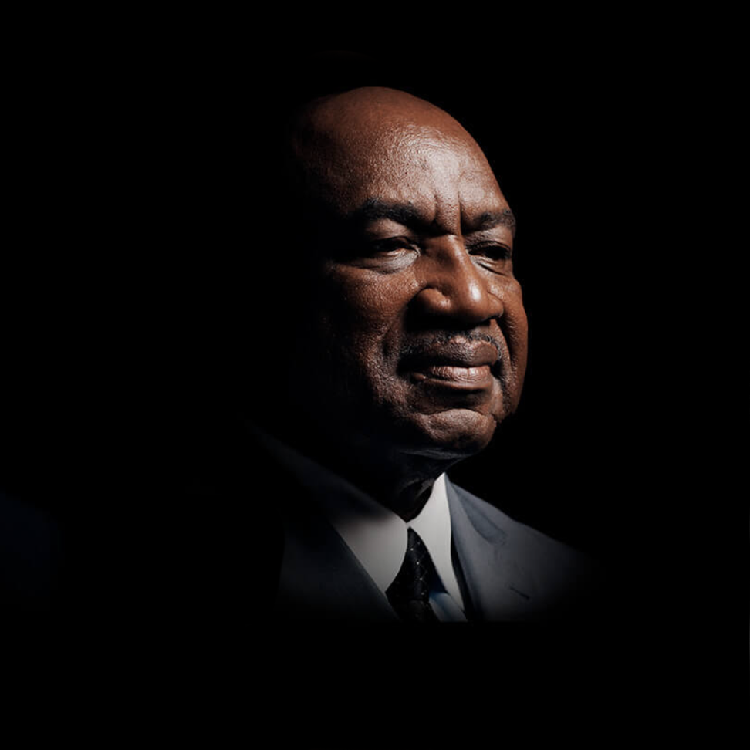
FAMILIES AND THEIR STORIES
CAIT LEAVEY
Cait lost her father, FDNY Lt. Joseph Leavey in the attack. She was just 10-years-old at the time. She found the tools to heal, at America’s Camp, organized for children who lost someone that day.
SCOTT STRAUSS
A detective with the Emergency Service Unit of the NYPD, Scott and his team rescued many, including Will Jimeno. Will’s partner John McLoughlin
MARY TOBIN
Mary was training in the U.S. Military Academy at West Point on 9/11. The attack changed the trajectory of her career.
DAVID LIM
David Lim was a member of the New York and New Jersey Police Departments. He lost his K-9 partner, Sirius when the South Tower collapsed.
GEORGE MARTIN
Former defensive end on the New York Giants, George founded: Journey for 9/11, a project to raise funds for ailing 9/11 rescue and recovery workers.
LEARN MORE ABOUT ALL 22 OF THE 9/11 DAY AMBASSADORS
https://911day.org/ambassadors/
Notes:
Many people’s lives changed on September 11, 2001. Some of these people wanted to do good deeds for others because of this.
A lot of people have stories about how 9/11 changed their lives.
They have shared their stories in short videos. They have also shared ideas of good deeds you can do.
What good deeds will you do this 9/11 Day?
[videos: https://911day.org/teachers/#videos]
[Good deeds: https://911day.org/resource-center/#good-deed-list]

