Slide 2
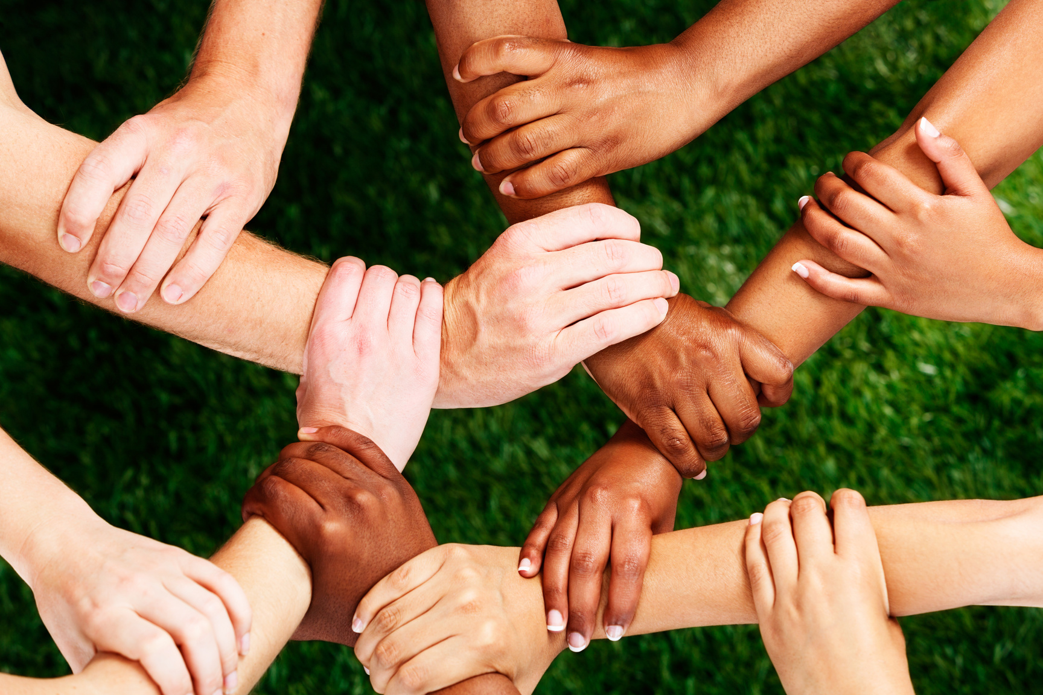
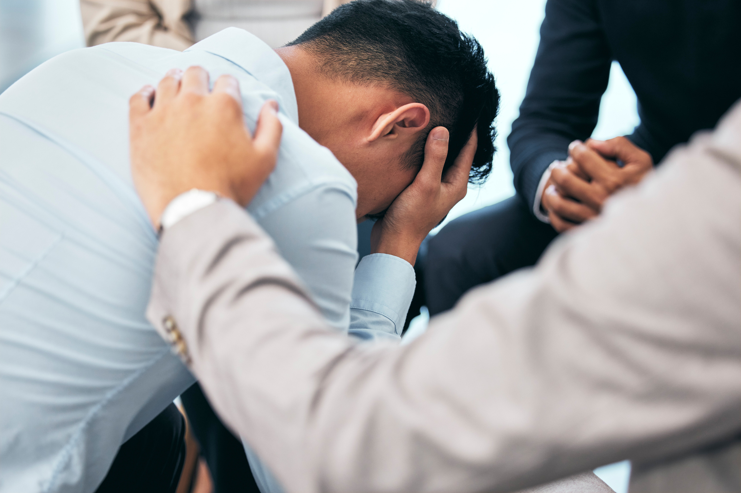

WHAT HAPPENED AFTER 9/11/2001?
Ac
UNITY
EMPATHY
SUPPORT
Notes:
After the events of September 11, 2001, people all across the country felt united. They wanted to help and support each other. There was a great spirit of empathy. People felt that together they could get through anything.
People were sad and confused, but this feeling of togetherness gave people some comfort and reassurance that everything would be ok. Many people stopped thinking about their differences. Instead, they were inspired to care for and help others. They realized that we are stronger when we work together.

Slide 3
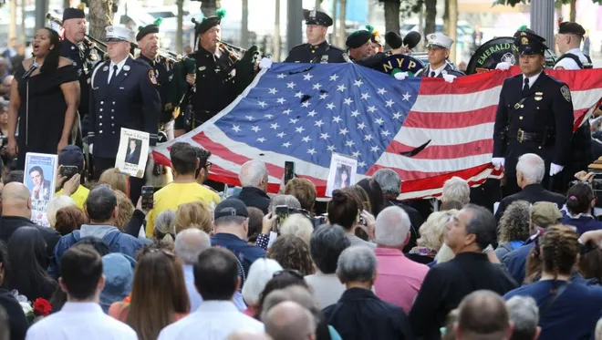
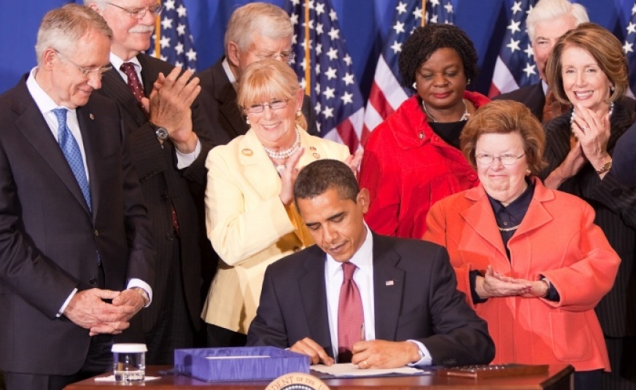
HOW DID 9/11 BECOME A DAY OF SERVICE?
Notes:
The family members of those who died were inspired to continue this sense of unity and compassion by turning September 11th into a Day of Service.
Their goal was to create a positive way for Americans to honor their lost loved ones.
September 11 officially became a National Day of Service and Remembrance in 2009 by an act passed by Congress and under a Presidential Proclamation signed by President Barack Obama.
The 9/11 National Day of Service is also known as “9/11 Day.”
The only other federally recognized Day of Service is Dr. Martin Luther King, Jr.’s birthday, which is recognized on the third Monday in January each year.

Slide 4
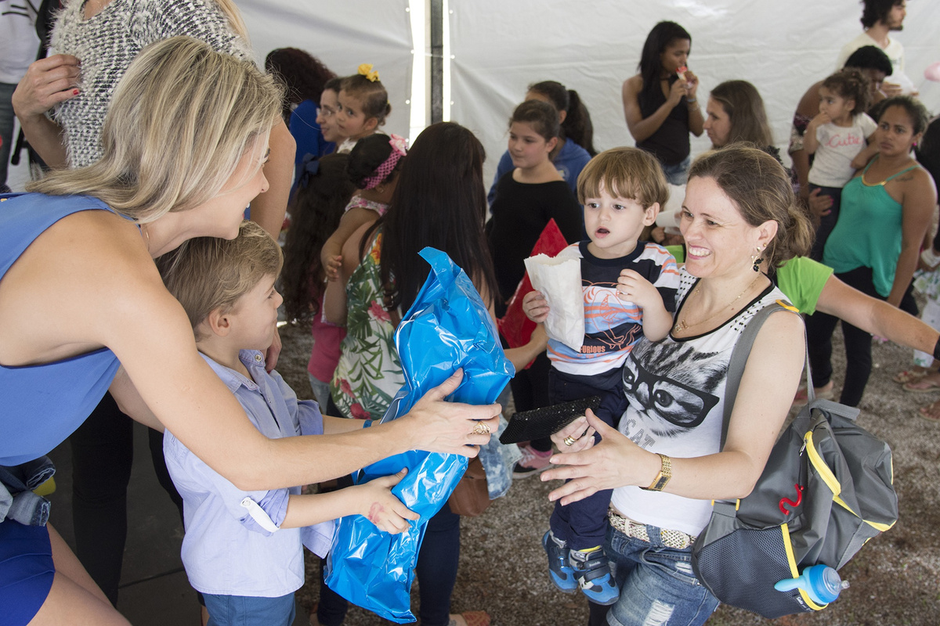
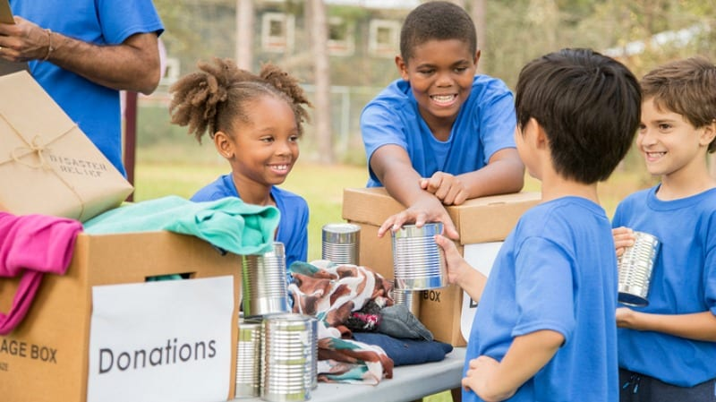
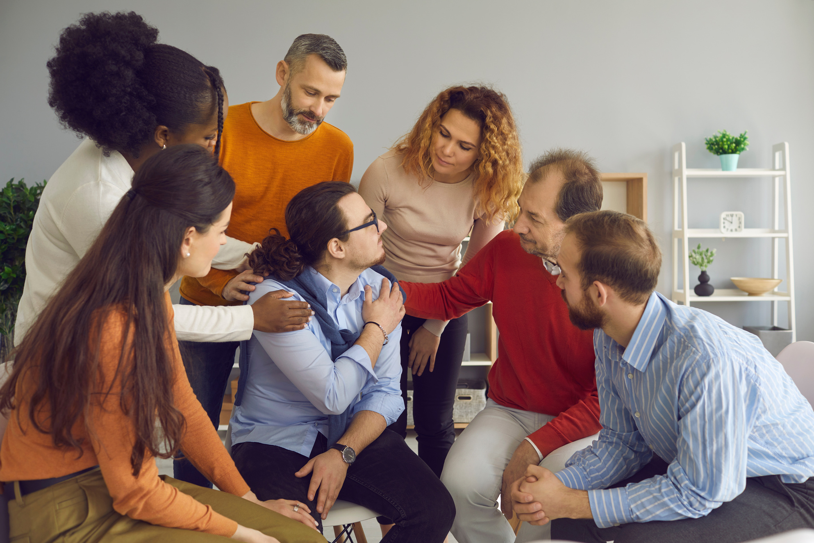
WHAT HAPPENS EACH YEAR ON 9/11?
Notes:
Since 2009, 9/11 has grown to become the largest annual day of service in America.
Tens of millions of people of all ages volunteer, support charities, do good deeds, and are kind to others.
People share their service projects in the news, social media, and elsewhere to encourage even more people to do good deeds for others.

Slide 5
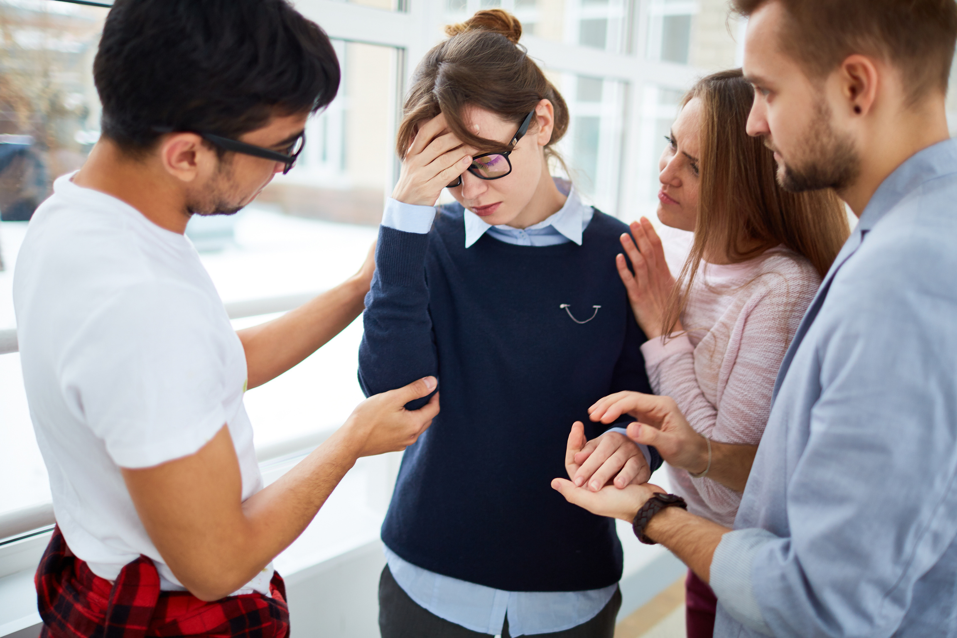
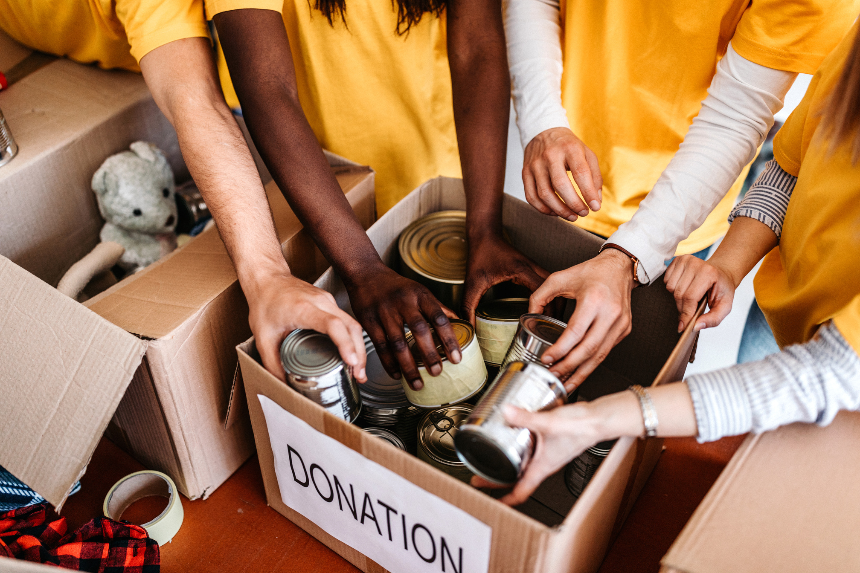
WHAT CAN THE LESSONS OF SEPTEMBER 11TH TEACH US?
Notes:
We can learn a lot from September 11th.
Moments of pain and challenge can create unity.
Kindness, empathy, and good deeds can make things better.
Everyone can make a difference.
There is more that unites us than divides us.

Slide 6
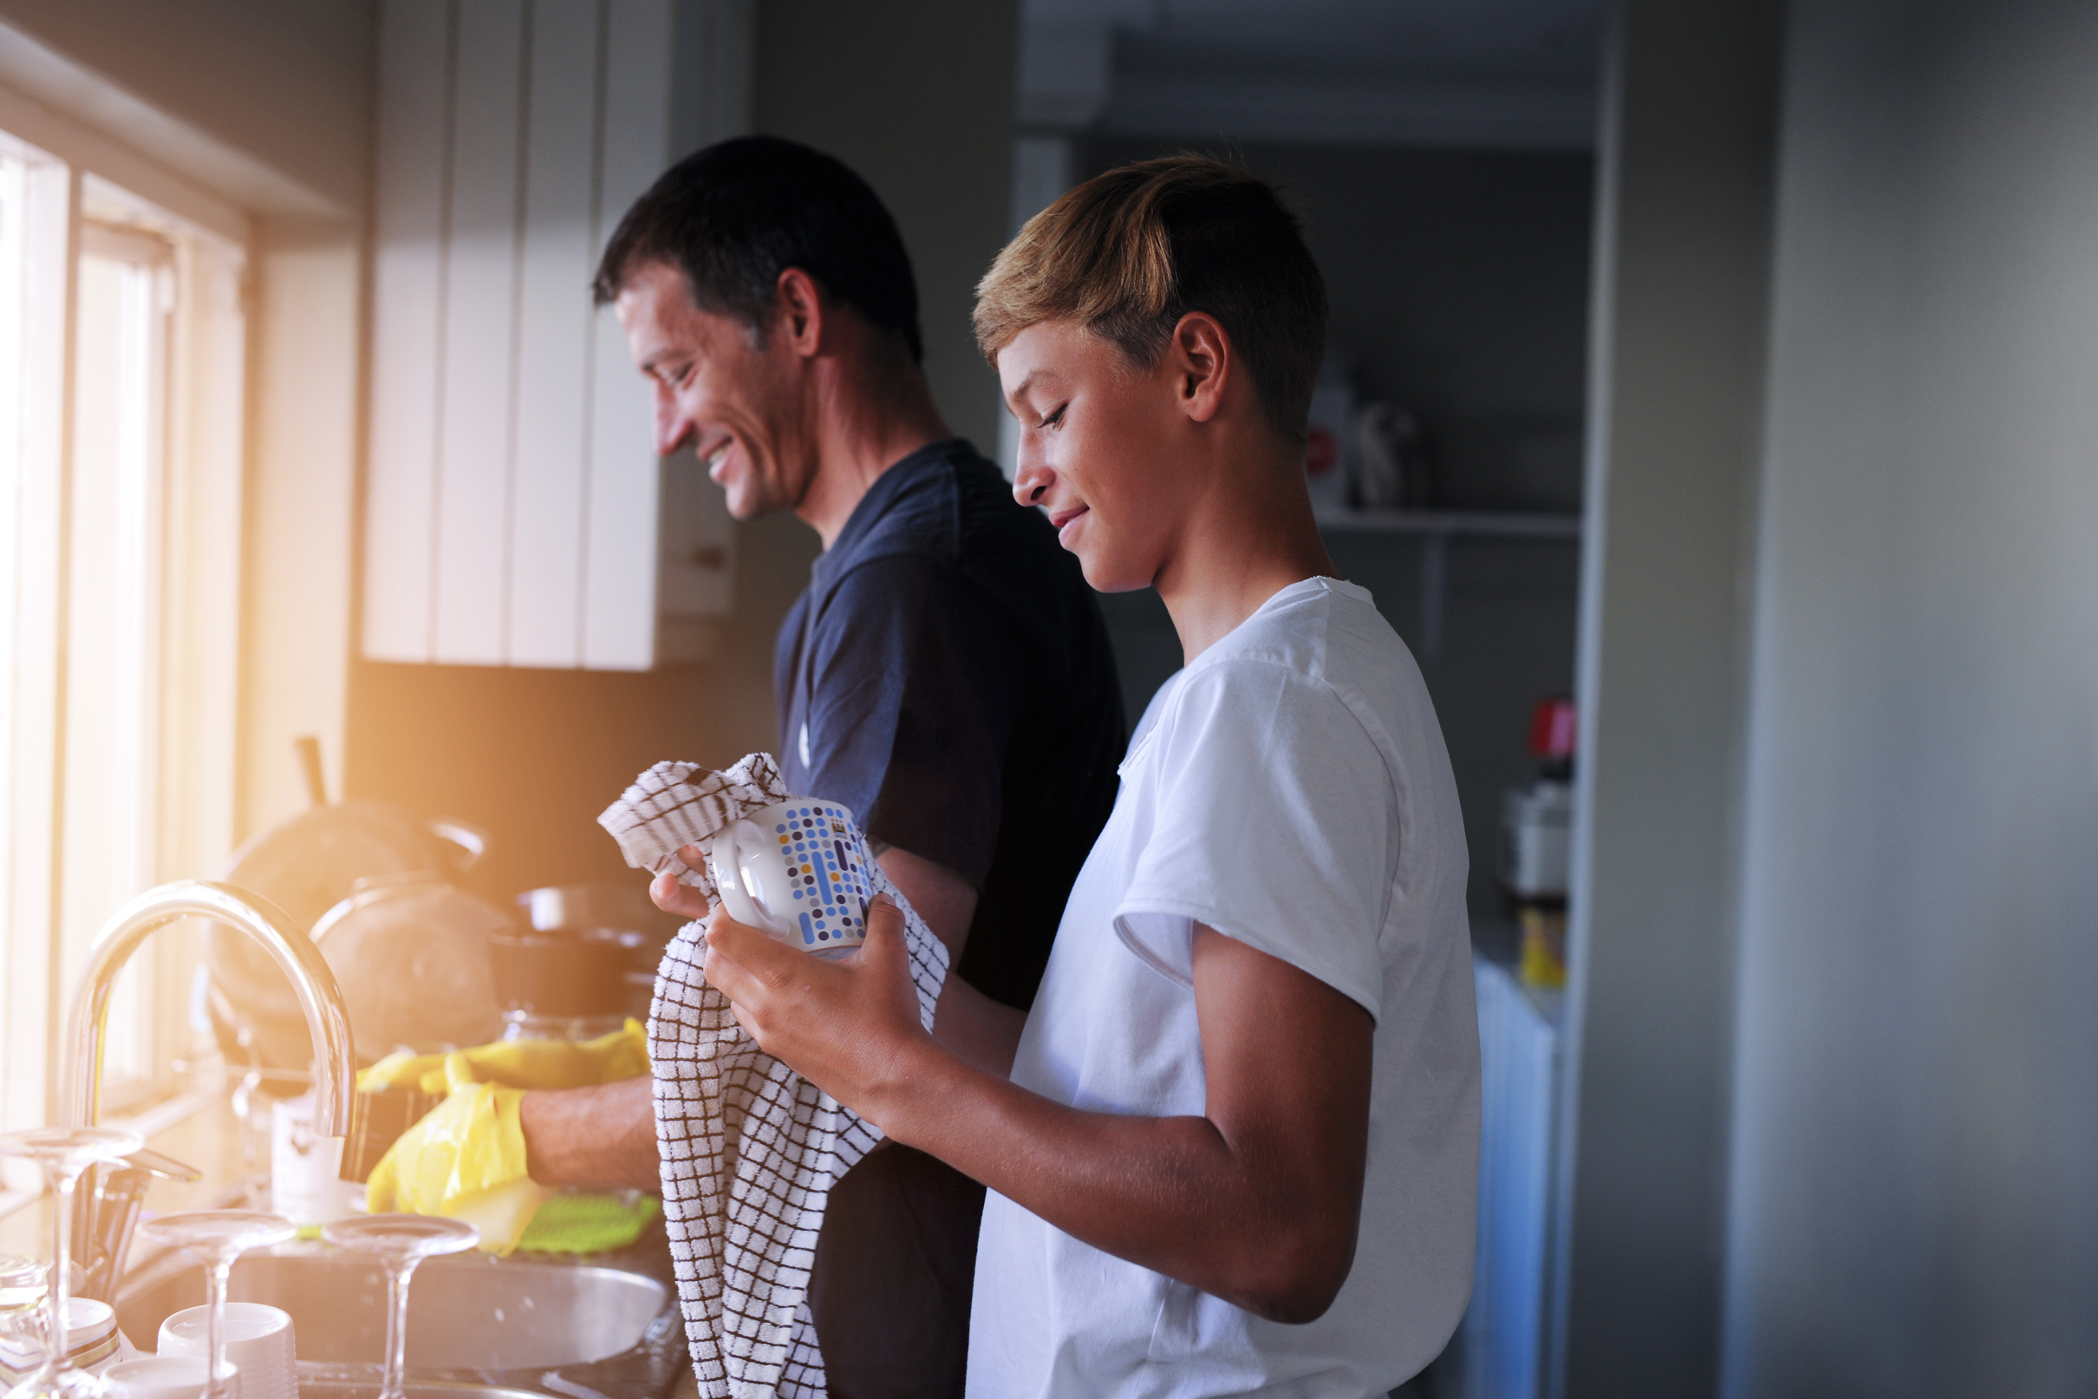
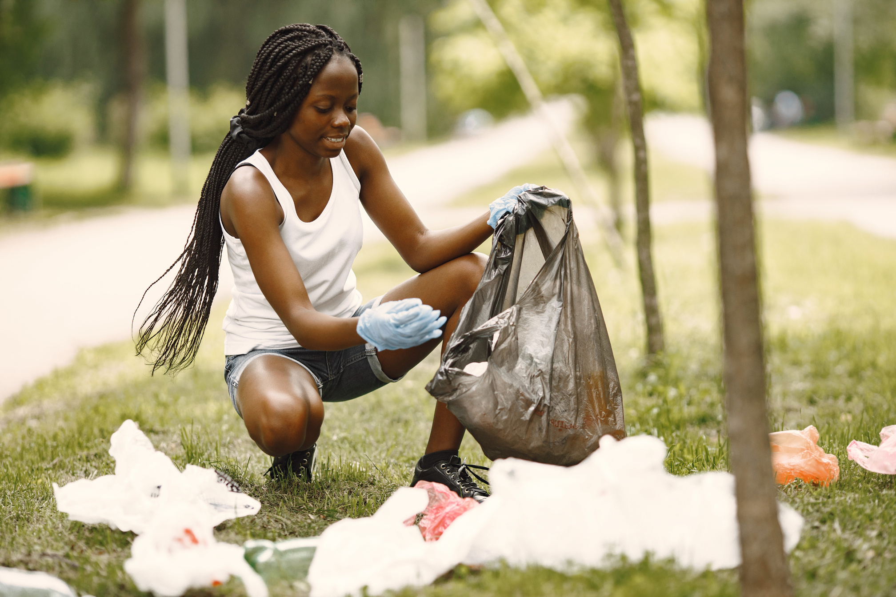

WHAT KIND OF GOOD DEEDS CAN YOU DO?
HOME
COMMUNITY
SCHOOL
Notes:
You can do good deeds at home, at school, or in the community.
At home you can:
Make your bed
Help around your house.
At school you can:
Pass out or collect papers for your teachers.
Help someone with their homework and be a better friend.
Help to clean the cafeteria after lunch.
Clean trash from the school yard or parks.
In the community you can:
Donate clothes, bikes, books, or household items.
Volunteer at a local organization that helps people in your community.
Join an outdoor clean-up effort.
Help at a community garden.
Collect donations for your local food bank.

Slide 7
ANY GOOD DEED COUNTS!
EVERYONE CAN DO A GOOD DEED!
WATCH THE VIDEO
https://www.youtube.com/watch?v=gHc901z_w4o
Notes:
Let’s watch a video about doing good deeds.

Slide 8
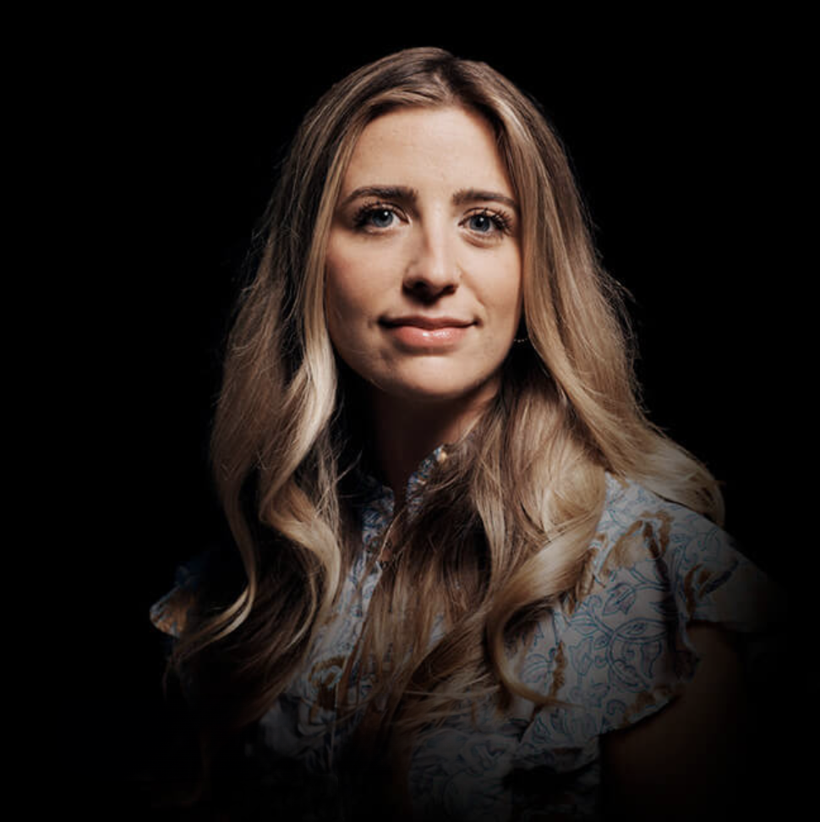
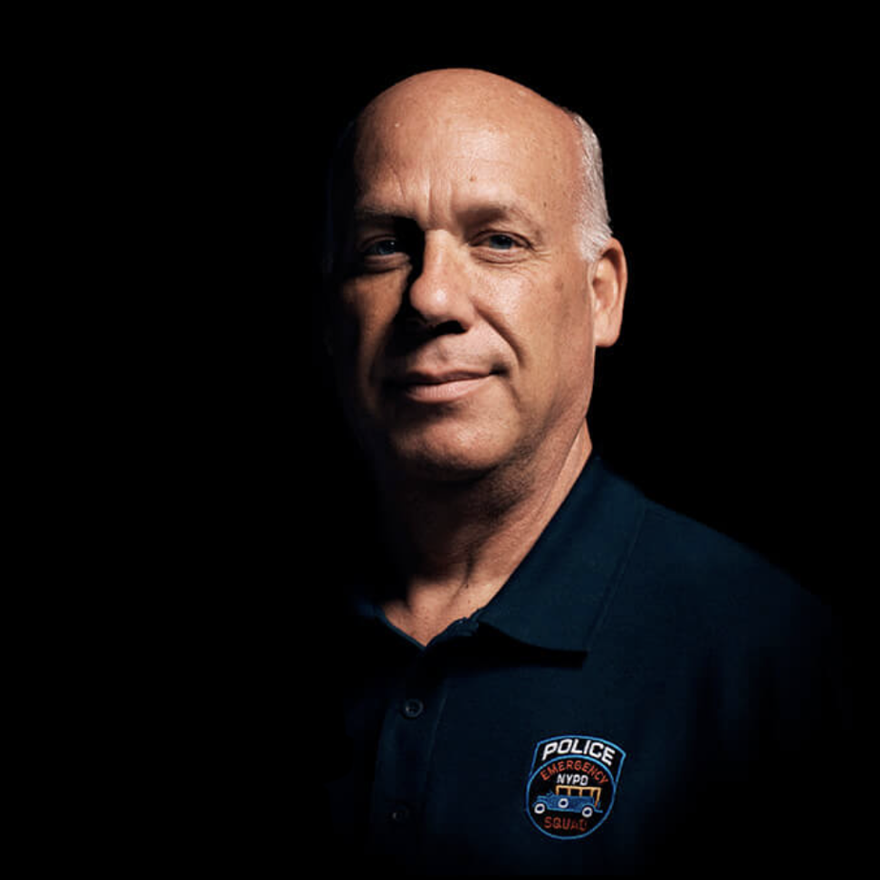
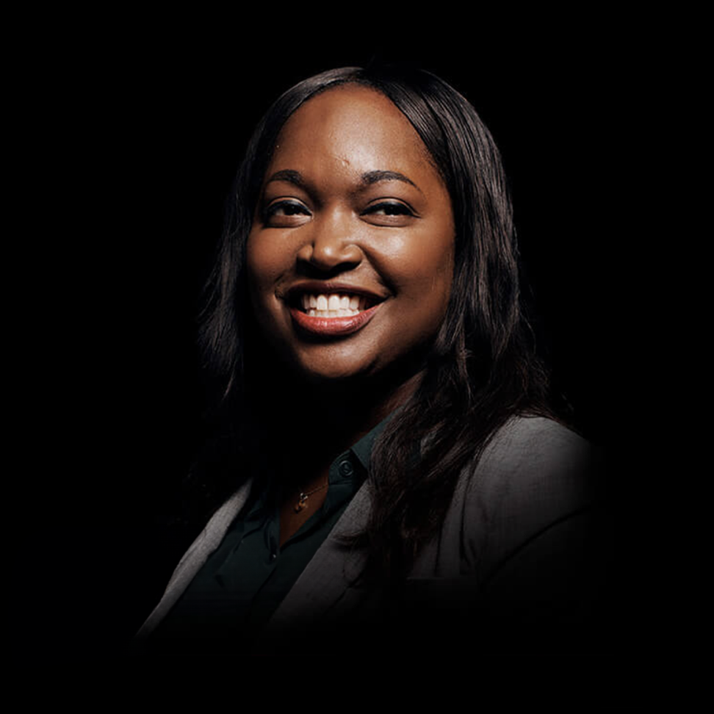
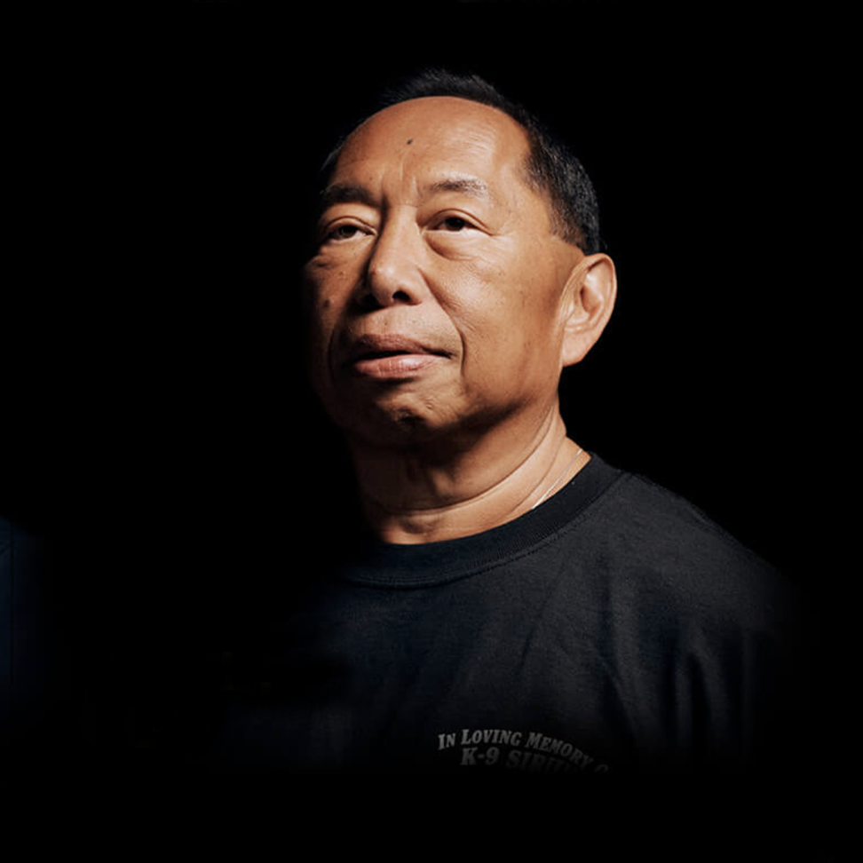
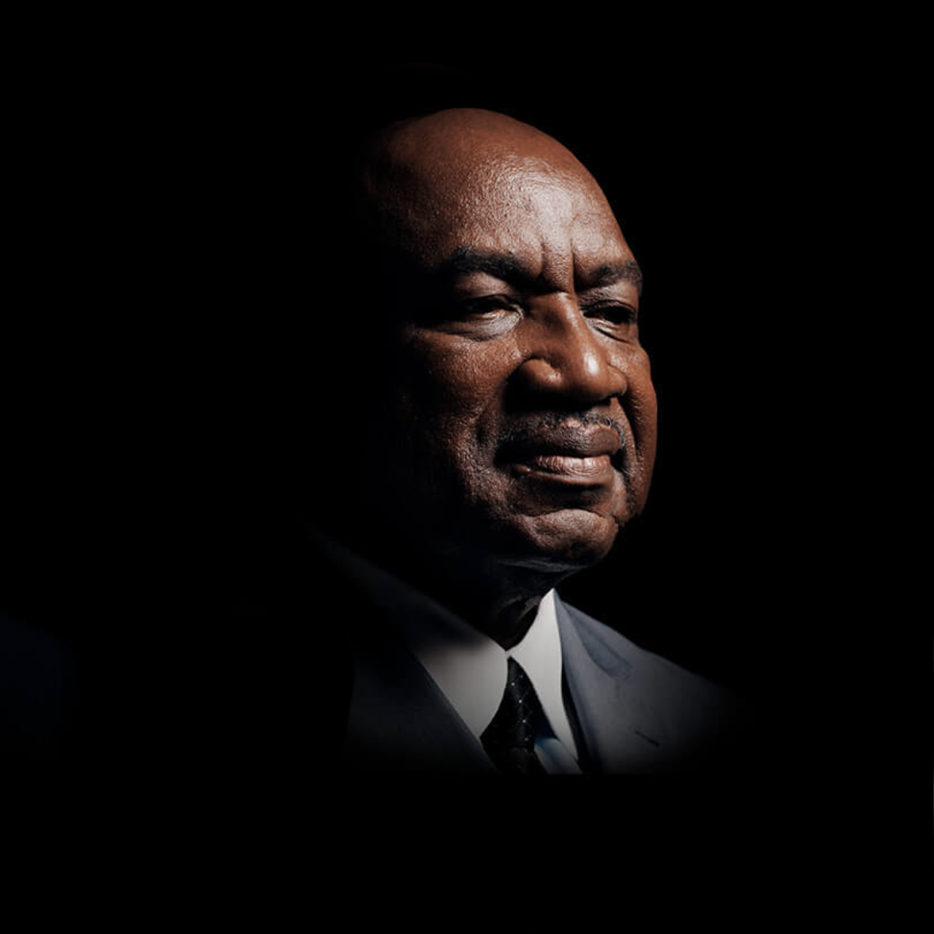
FIRST HAND WITNESSES AND THEIR INSPIRING STORIES
CAIT LEAVEY
Cait lost her father, FDNY Lt. Joseph Leavey in the attack. She was just 10-years-old at the time. She found the tools to heal, at America’s Camp, organized for children who lost someone that day.
SCOTT STRAUSS
A detective with the Emergency Service Unit of the NYPD, Scott and his team rescued many, including Will Jimeno. Will’s partner John McLoughlin
MARY TOBIN
Mary was training in the U.S. Military Academy at West Point on 9/11. The attack changed the trajectory of her career.
DAVID LIM
David Lim was a member of the New York and New Jersey Police Departments. He lost his K-9 partner, Sirius when the South Tower collapsed.
GEORGE MARTIN
Former defensive end on the New York Giants, George founded: Journey for 9/11, a project to raise funds for ailing 9/11 rescue and recovery workers.
LEARN MORE ABOUT ALL 22 OF THE 9/11 DAY AMBASSADORS
https://911day.org/ambassadors/
Notes:
Twenty-one people with close, personal ties to the events of September 11, 2001 were inspired to make changes and do good deeds as a result of how their lives were affected.
Each one has a unique perspective on how 9/11 impacted and changed lives forever.
They and many others have shared their stories as well as ideas of good deeds to do on this Day of Service.
How will you be of service this 9/11 Day?
[videos: https://911day.org/teachers/#videos]
[Good deeds: https://911day.org/resource-center/#good-deed-list]

