Slide 2
WHAT HAPPENED AFTER 9/11/2001?
Ac
UNITY
EMPATHY
SUPPORT
Notes:
After what happened on September 11, people all across the country come together. They were better able to understand how others were feeling. People felt that together they could get through anything. They began to help each other.
People were sad and confused, but this feeling of togetherness made people think that everything was going to be ok. Many people stopped thinking about how everyone is different. They focused more on how people are all alike.

Slide 3
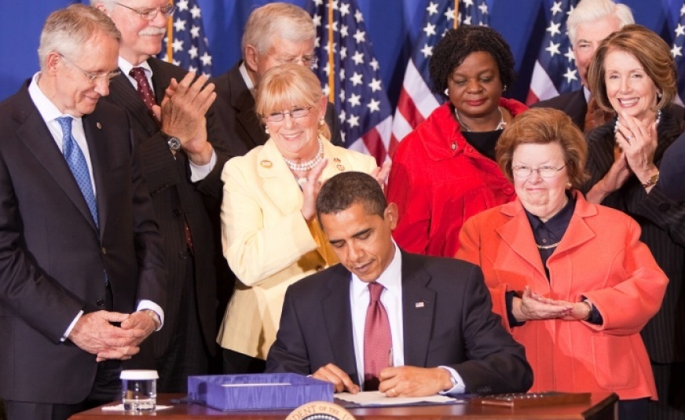
HOW DID 9/11 BECOME A DAY OF SERVICE?
Notes:
The family of those who died wanted to continue this feeing of togetherness by making September 11th a Day of Service.
They wanted to create a positive way for Americans to honor their lost loved ones.
Congress and President Barack Obama made September 11 a National Day of Service and Remembrance in 2009.
The 9/11 National Day of Service is also known as “9/11 Day.”
The only other Day of Service is Dr. Martin Luther King, Jr.’s birthday, which is on the third Monday in January each year.

Slide 4
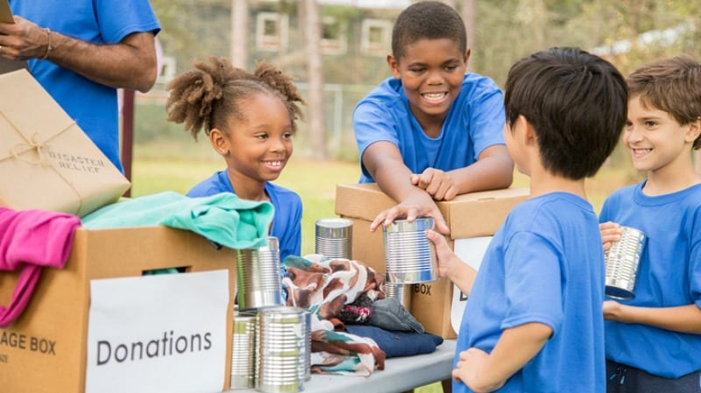
WHAT HAPPENS EACH YEAR ON 9/11?
v
Notes:
Since 2009, 9/11 has become the largest day of service in America.
Millions of people each year volunteer, help charities, do good deeds, and are kind to others.
People share their good deeds to try to get even more people to do good deeds for others.

Slide 5
WHAT CAN SEPTEMBER 11TH TEACH US?
Notes:
We can learn a lot from September 11th.
When things are difficult, people often come together.
Being kind and doing good deeds can make things better.
Everyone can make a difference.
We are more alike than we are different.

Slide 6
WHAT KIND OF GOOD DEEDS CAN YOU DO?
HOME
COMMUNITY
SCHOOL
Notes:
You can do good deeds at home, at school, or in the community.
At home you can:
Make your bed
Help around your house.
At school you can:
Help your teachers.
Help someone with their homework and be a better friend.
Help clean the cafeteria after lunch.
Pick up trash when you see it.
In your community you can:
Give away clothes, bikes, books, or household items that you don’t use.
Join a group that is cleaning up an outdoor area.
Help at a community garden.
Collect cans for your local food bank.

Slide 7
ANY GOOD DEED COUNTS! EVERYONE CAN DO A GOOD DEED!
WATCH THE VIDEO
https://www.youtube.com/watch?v=gHc901z_w4o
Notes:
Let’s watch a video about doing good deeds.

Slide 8
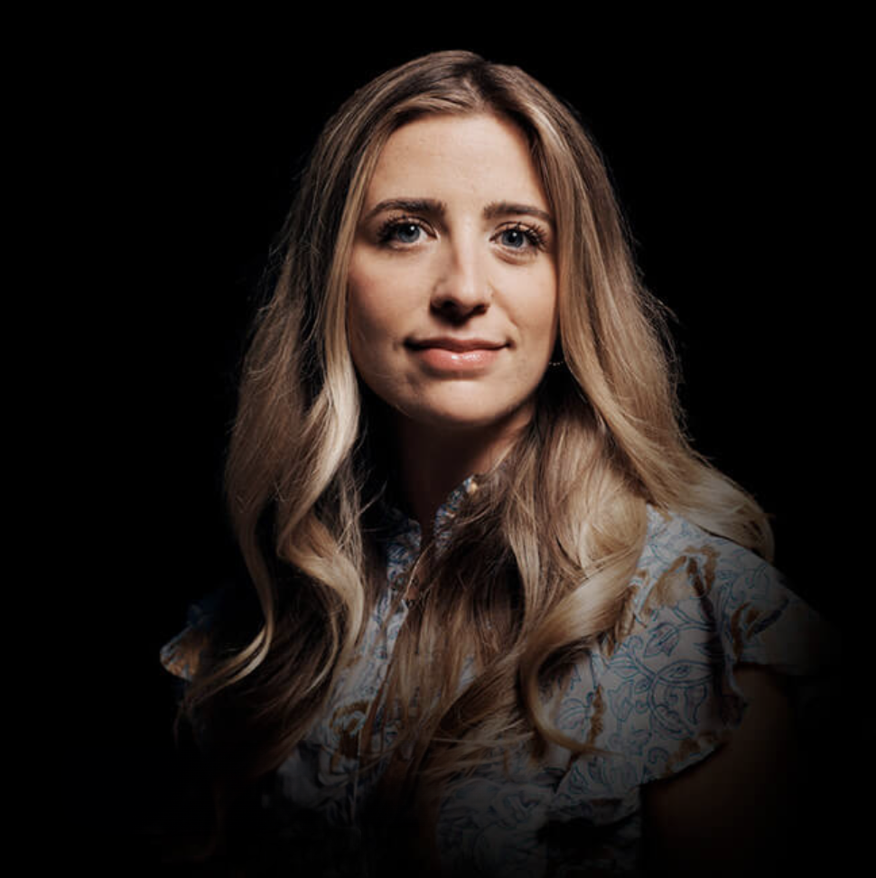
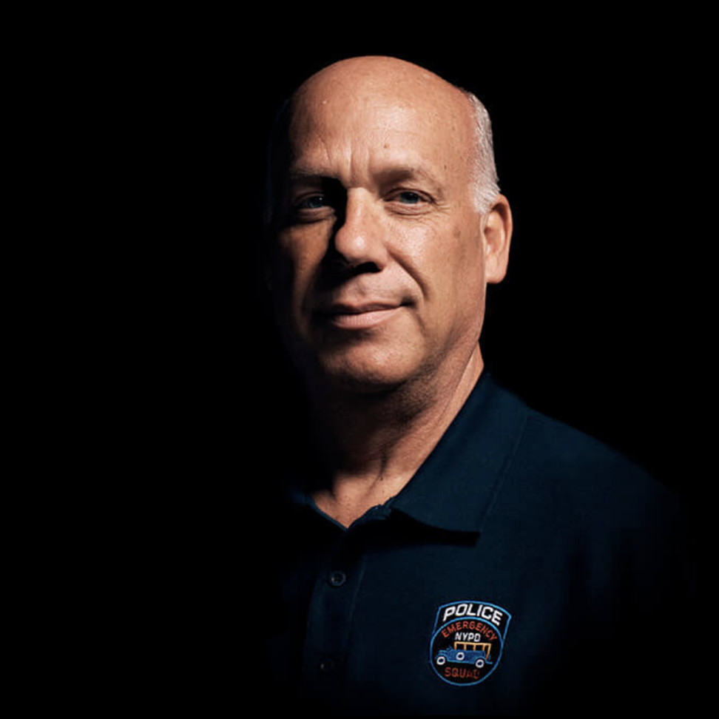
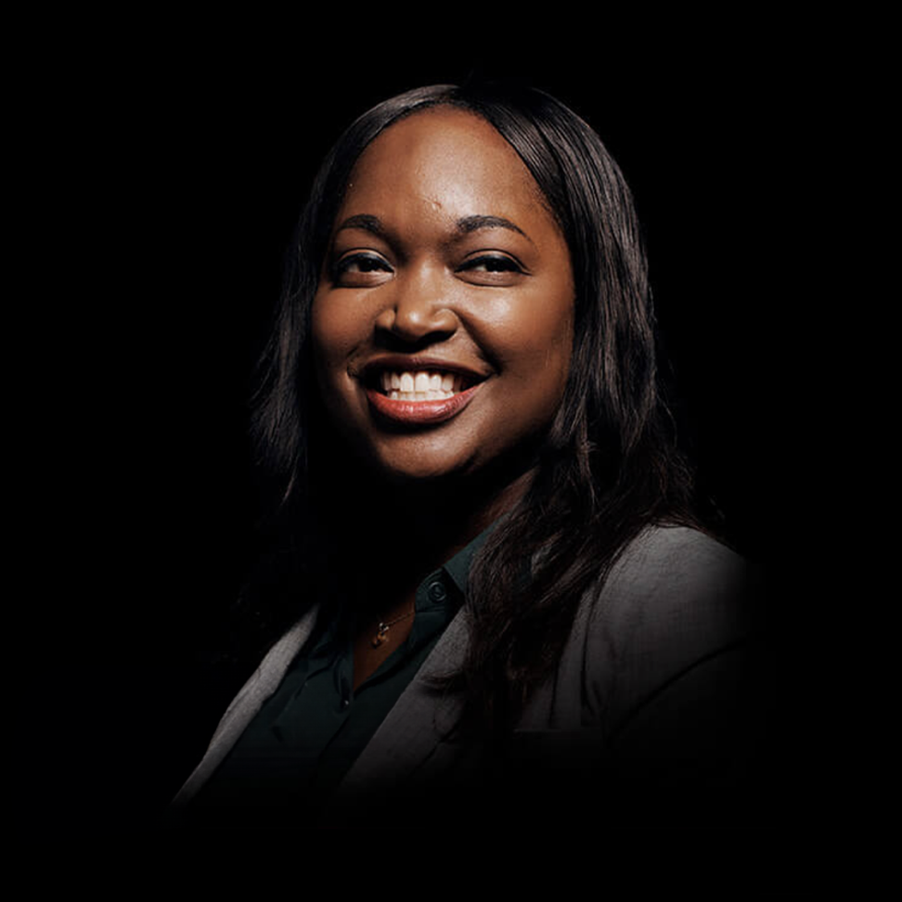
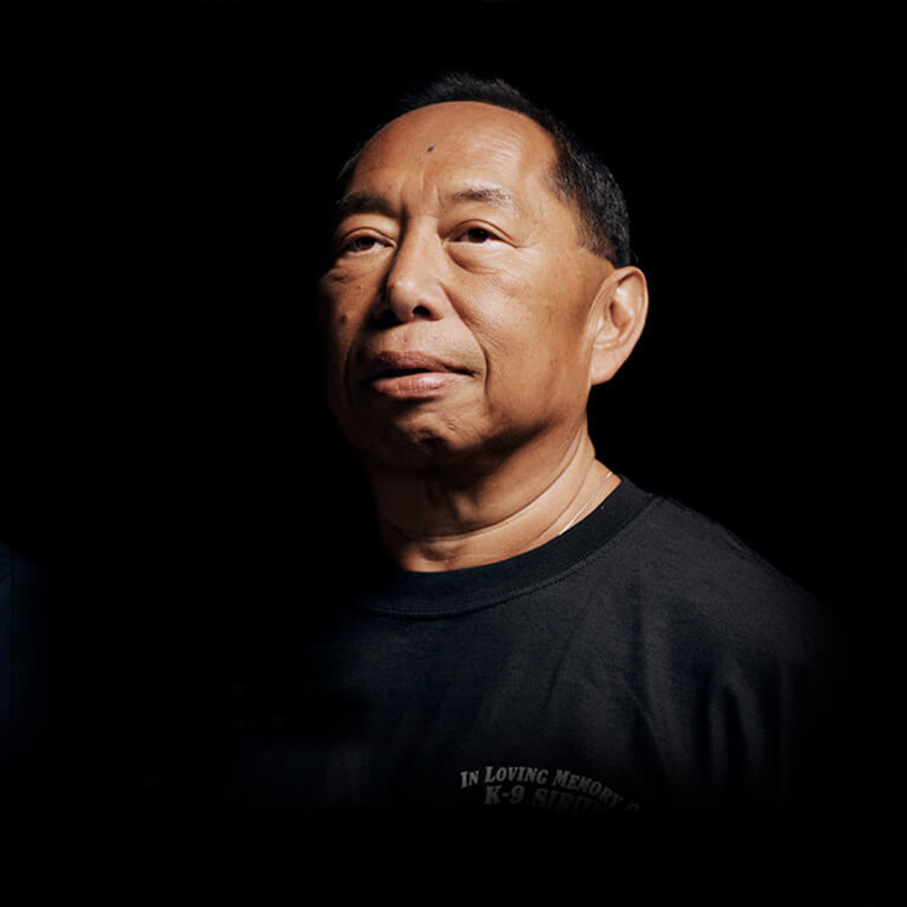
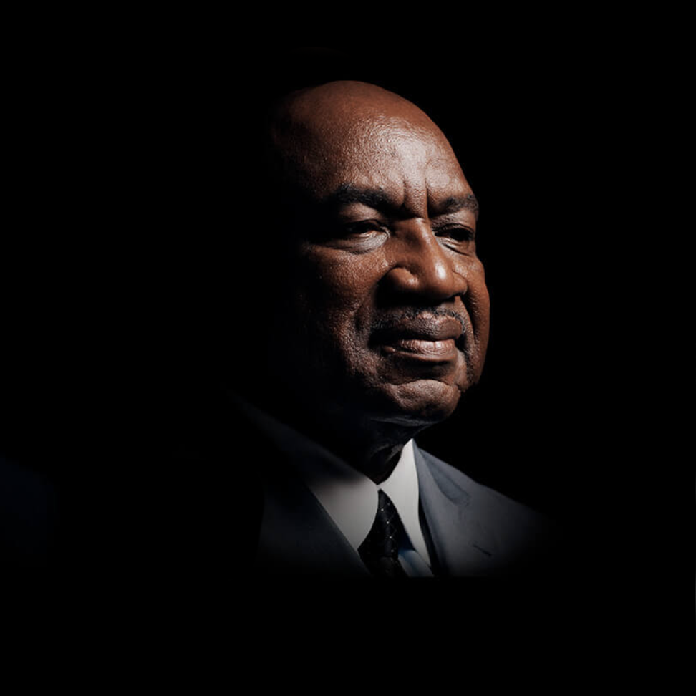
PEOPLE AFFECTED BY 9/11 AND THEIR STORIES
CAIT LEAVEY
Cait lost her father, FDNY Lt. Joseph Leavey in the attack. She was just 10-years-old at the time. She found the tools to heal, at America’s Camp, organized for children who lost someone that day.
SCOTT STRAUSS
A detective with the Emergency Service Unit of the NYPD, Scott and his team rescued many, including Will Jimeno. Will’s partner John McLoughlin
MARY TOBIN
Mary was training in the U.S. Military Academy at West Point on 9/11. The attack changed the trajectory of her career.
DAVID LIM
David Lim was a member of the New York and New Jersey Police Departments. He lost his K-9 partner, Sirius when the South Tower collapsed.
GEORGE MARTIN
Former defensive end on the New York Giants, George founded: Journey for 9/11, a project to raise funds for ailing 9/11 rescue and recovery workers.
LEARN MORE ABOUT ALL 22 OF THE 9/11 DAY AMBASSADORS
https://911day.org/ambassadors/
Notes:
People with close, personal ties to the events of September 11, 2001 wanted to make changes and do good deeds because of how their lives were affected.
Each one has a story about how 9/11 changed their lives forever.
They have shared their stories and ideas of good deeds you can do on this Day of Service.
What good deeds will you do this 9/11 Day?
[videos: https://911day.org/teachers/#videos]
[Good deeds: https://911day.org/resource-center/#good-deed-list]

